Slide 1
Credit Card Approval Prediction
Tools used for Analzing Data : Python(jupyter Notebook), Machine Leaning, Excel

Slide 2
Objectives:
Problem Statement: The task is to analyze and build a predictive model that can accurately determine whether a credit card application
should be approved or rejected based on various applicant attributes and historical credit data.
Goal of the Project: The goal is to develop a model that can that can assist financial institutions in making informed decisions while
minimizing the risk of default and maximizing profitability.
They have given a problem to identify the customers segments which are eligible for Credit Card approval, so that they can specifical

Slide 3
Column name: Description
ID Unique Id of the row
CODE_GENDER Gender of the applicant. M is male and F is female.
FLAG_OWN_CAR Is an applicant with a car? Y is Yes and N is NO.
FLAG_OWN_REALTY Is an applicant with realty? Y is Yes and N is No.
CNT_CHILDREN Count of children.
AMT_INCOME_TOTAL the amount of the income.
NAME_INCOME_TYPE The type of income (5 types in total).
NAME_EDUCATION_TYPE The type of education (5 types in total).
NAME_FAMILY_STATUS The type of family status (6 types in total).
DAYS_BIRTH The number of the days from birth (Negative values).
DAYS_EMPLOYED The number of the days from employment (Negative values). This column has error values.
FLAG_MOBIL Is an applicant with a mobile? 1 is True and 0 is False
FLAG_WORK_PHONE Is an applicant with a work phone? 1 is True and 0 is False.
FLAG_PHONE Is an applicant with a phone? 1 is True and 0 is False.
FLAG_EMAIL Is an applicant with an email? 1 is True and 0 is False.
OCCUPATION_TYPE The type of occupation (19 types in total). This column has missing values.
CNT_FAM_MEMBERS The count of family members.

Slide 4
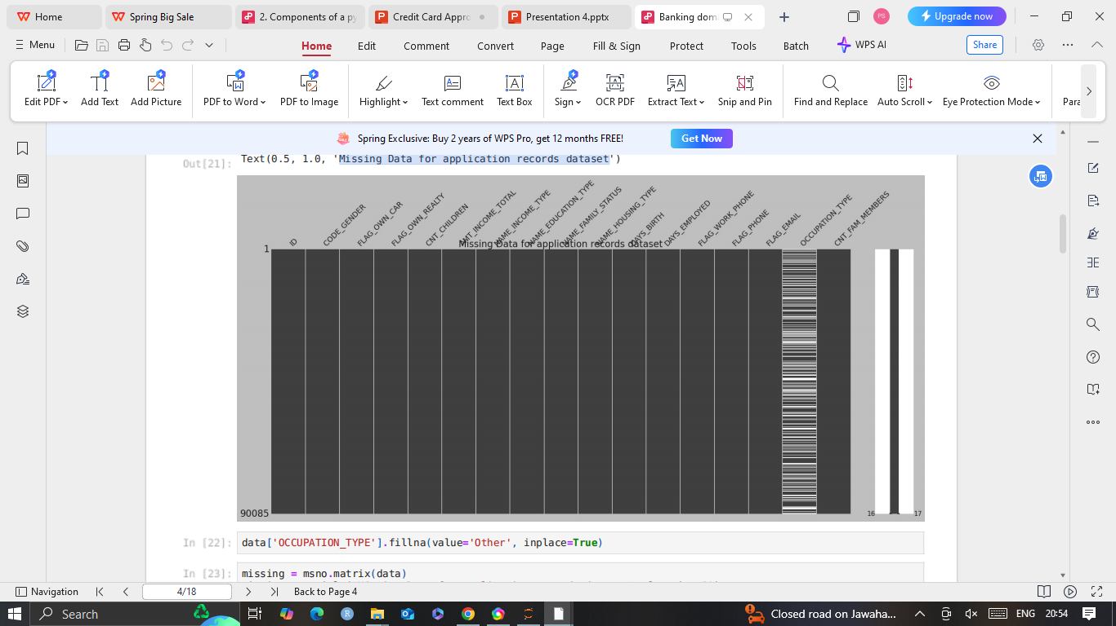
Missing Data for application records dataset

Slide 5
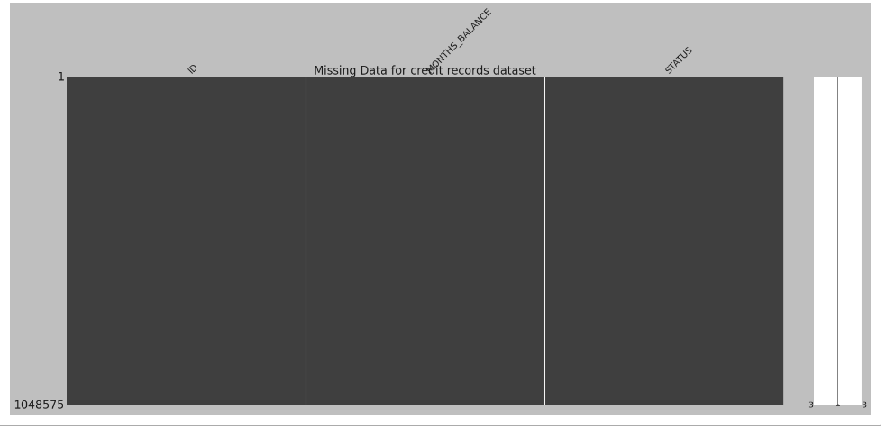
Missing Data for credit records dataset

Slide 6
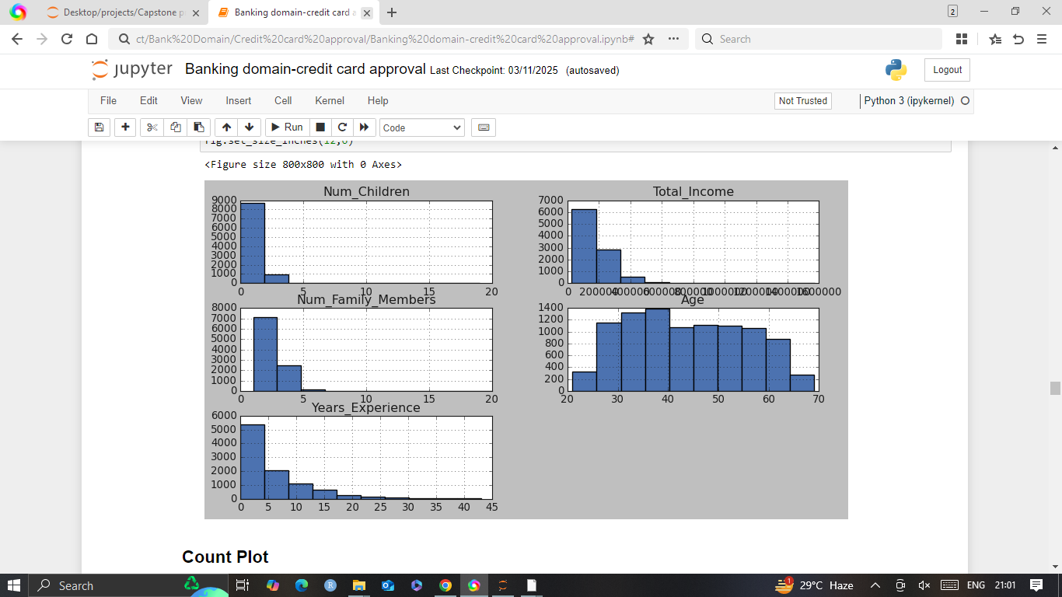
Count of observations of children,income,years of experience ,age.

Slide 7
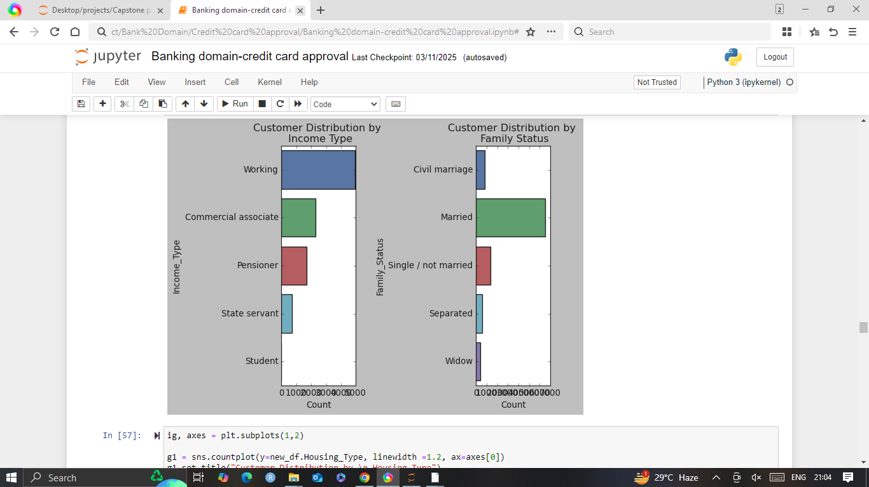
Customer Distribution by \n Income Type & Customer Distribution by \n Family Status

Slide 8
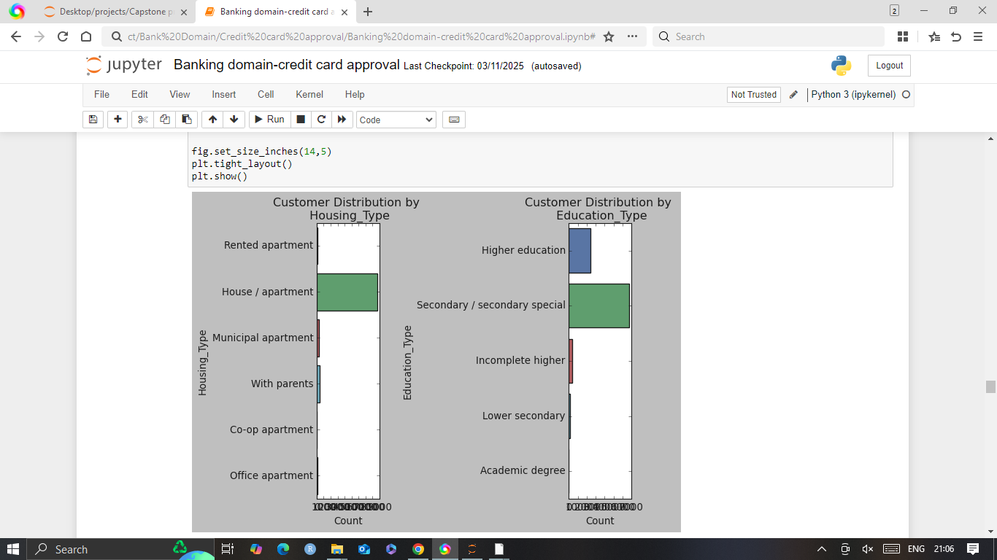
Customer Distribution by \n Housing_Type & Customer Distribution by \n Education_Type

Slide 9
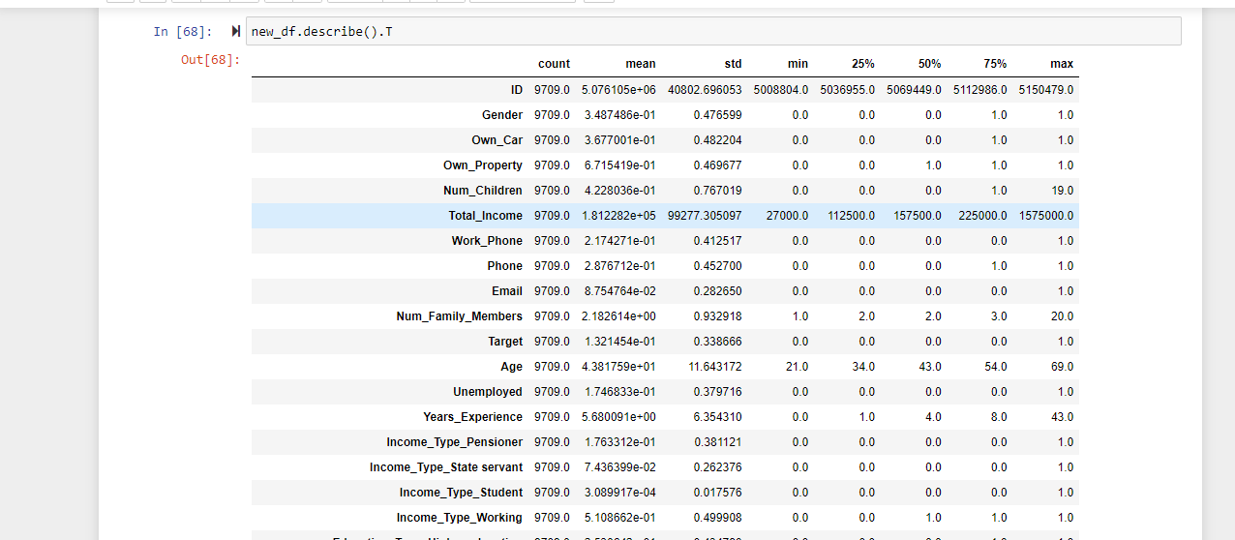
Central tendency of the data set

Slide 10
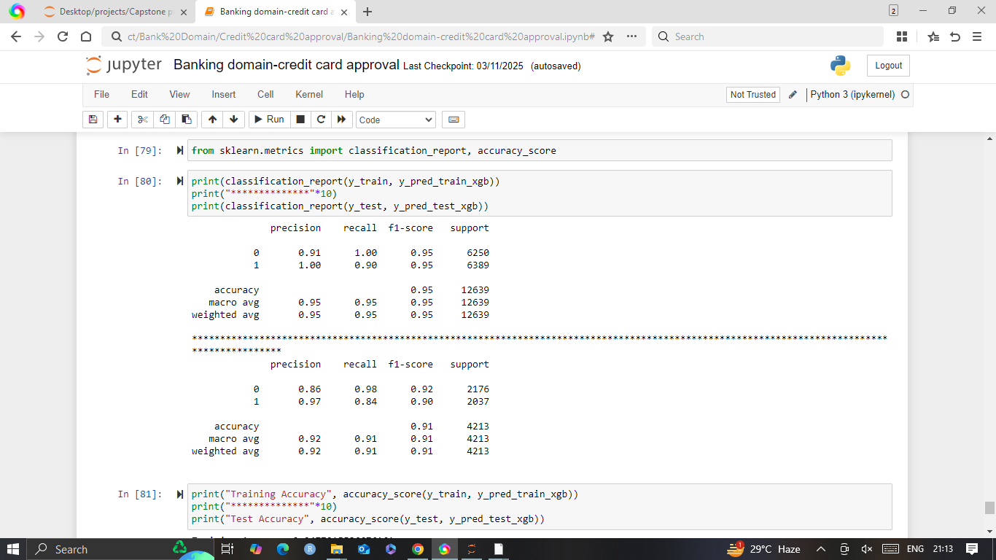
Classification report and Accuracy Score

Slide 11
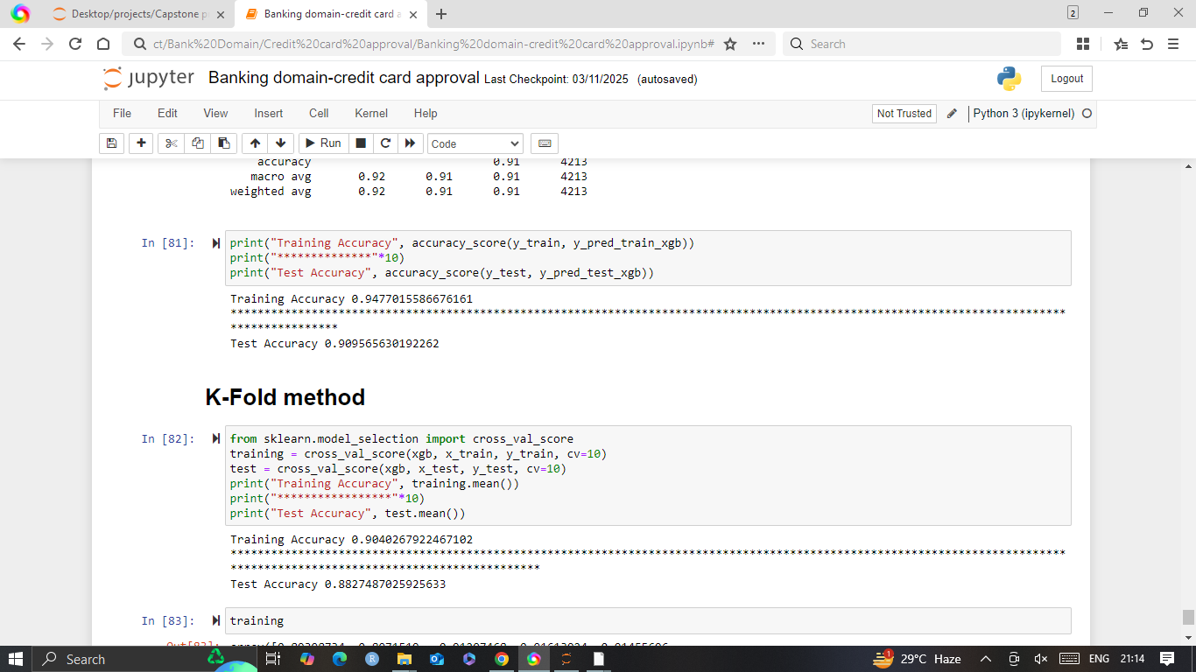
Test Accuracy

Slide 12
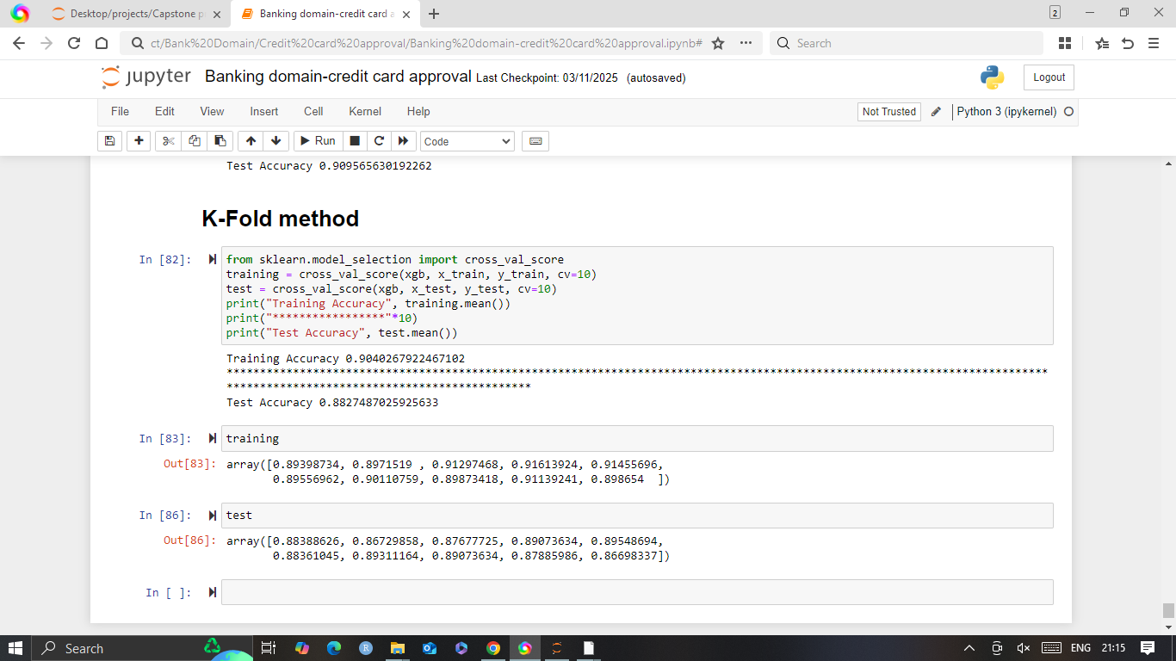
Training accuracy and Test Accuracy

